Slide 1
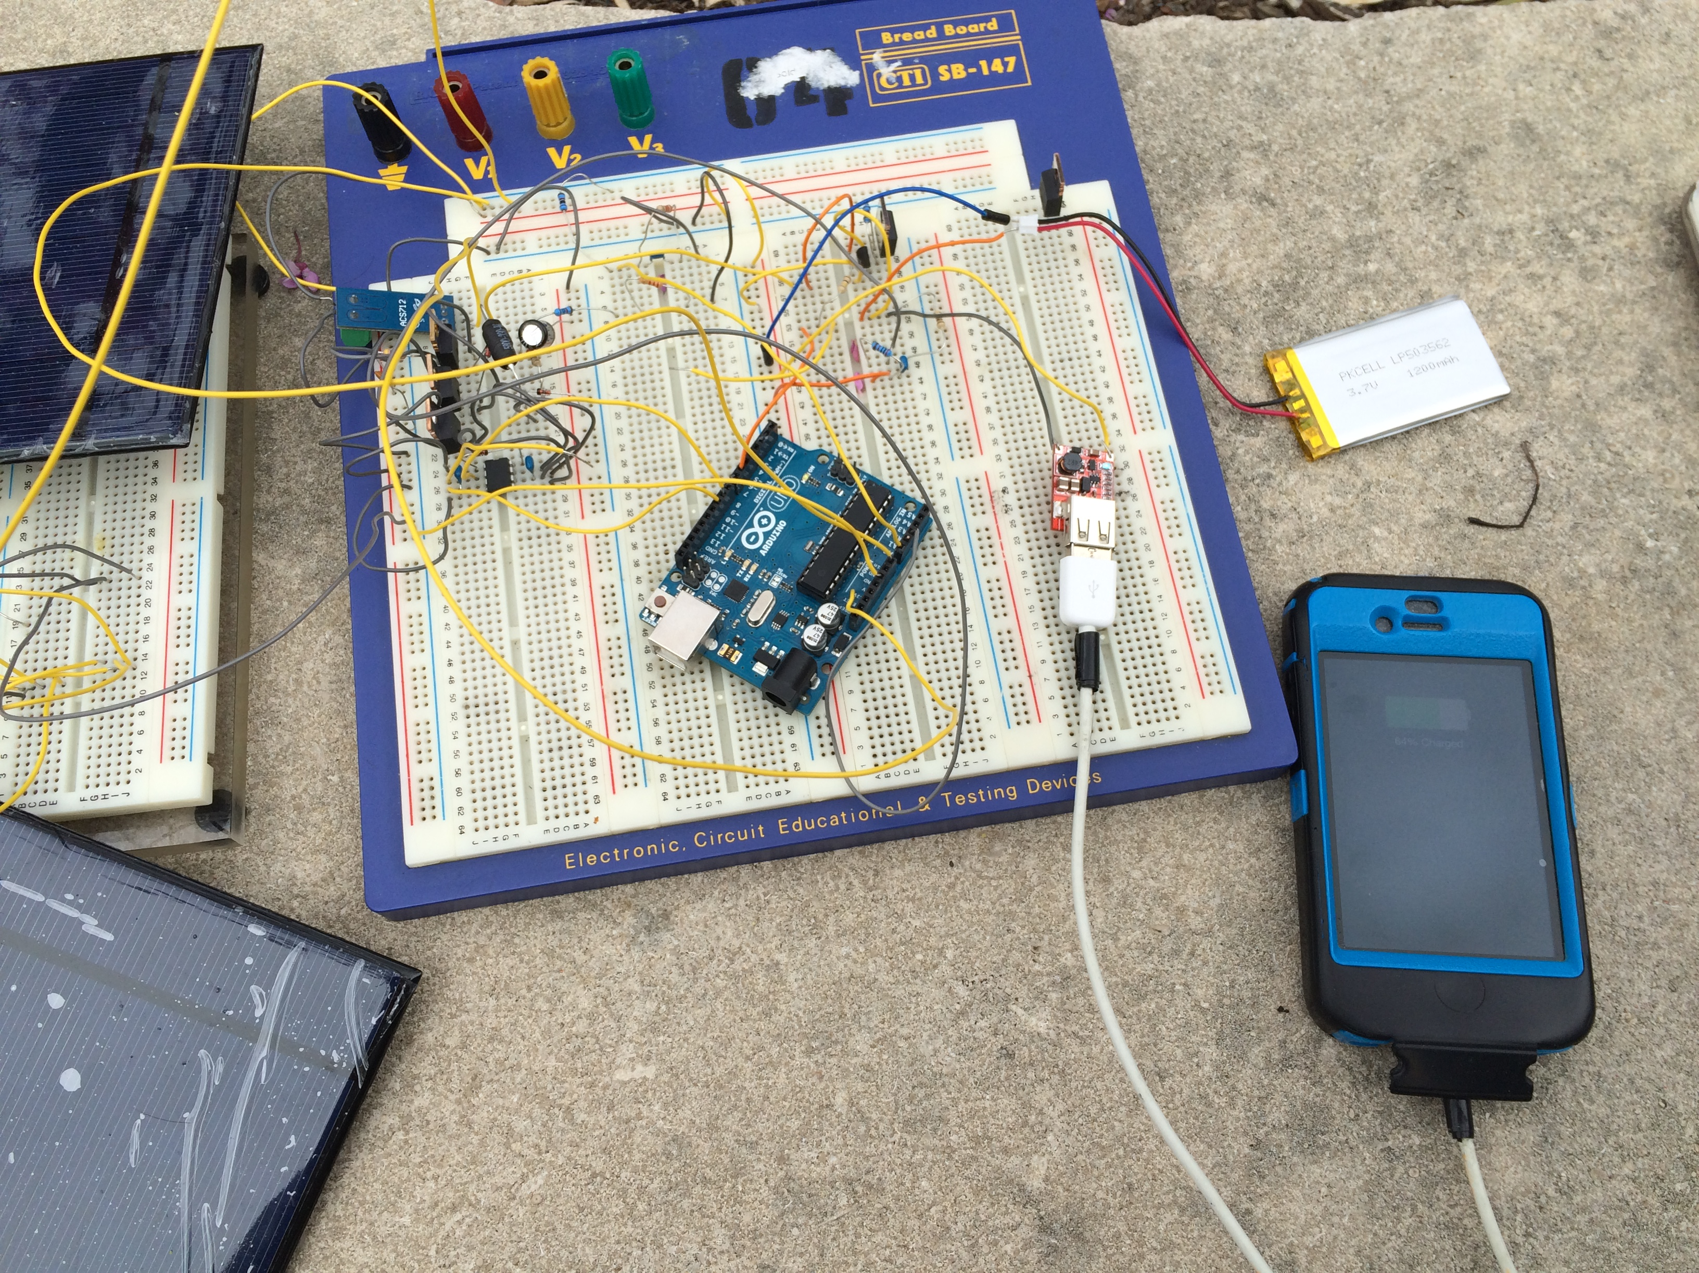
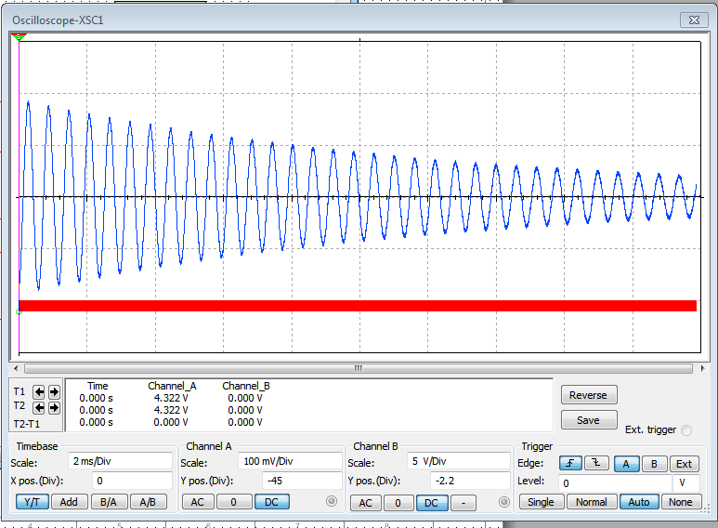
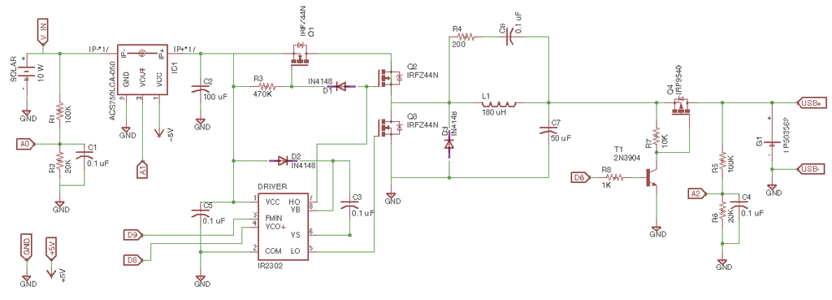
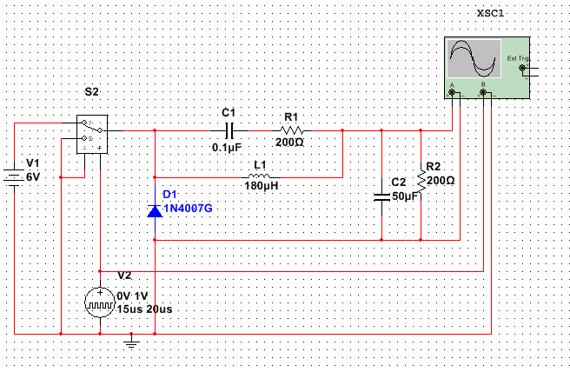
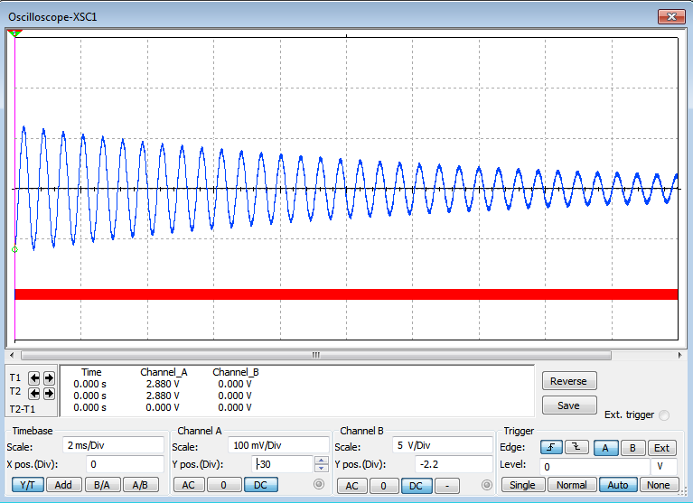
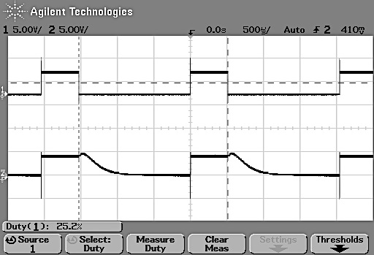
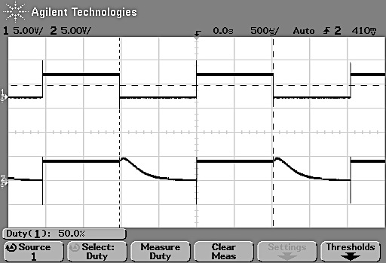
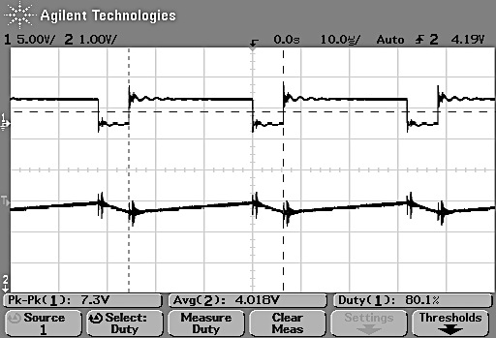
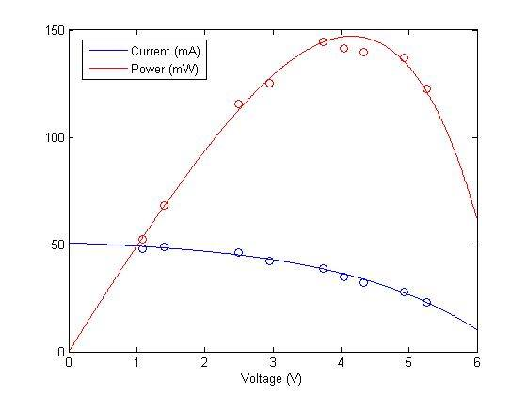
Solar-Powered Lithium-Ion Battery Charger with USB Connector
Eric Hsu, Arunita Kar, John Yuan
Department of Electrical and Systems Engineering, ESE 498 – Senior Design Project, 2015
MOTIVATION
PROJECT SETUP
DISCUSSION
Mobile phones are some of the most pervasive electronic devices. Despite numerous makes and models of cellphones, they all have a common component – batteries. Having battery-powered devices requires recharging. In reality, it is inconvenient to find and wait at an electrical outlet while walking, biking or traveling in general, and keeping the phone battery alive is necessary in for entertainment, information, and emergencies. Perhaps the largest audience for our product is college students, who are frequently walking from class to class or other places both on and off campus. This problem presents a need for on-the-go charging devices that use renewable energy to charge a battery.
Figure 1. Block diagram of solar-powered battery charger.
In this project we designed and implemented an MPPT charge controller circuit from scratch. The main goal was to deliver power from an array of solar panels to a Li-ion battery in order to charge it. To obtain charging efficiency, we set up a maximum power-point tracking circuit that would ensure that the greatest amount of power is delivered to the battery. The Buck-converter was used to regulate the voltage delivered to the battery. Since the solar panels generate a much higher voltage than what the battery requires to reach full charge, the Buck-converter performs voltage step-down.
We optimize our Buck-converter by choosing inductance and capacitance values so that the power is maximized at near 4 V, which is the perfect voltage for charging the 3.7 V Li-ion battery. Combined with our charge controller, which decreases the amount of voltage flowing into the battery as the battery voltage approaches 3.7 V, our battery will never be
Photovoltaic System
(Solar Panels)
Charge Regulation Circuit
DC-DC Converter (Buck)
Li-ion Battery
USB
Arduino-based charge controller
The circuit design focuses on controlling the charge provided from the solar panels to the battery. An Arduino has been programmed for PWM to control the MPPT capability, which allows us to obtain the greatest amount of power from the availability of light. A Buck converter has been implemented for voltage regulation. Once energy is stored in the battery, we have the capability to charge devices such as cellphones, iPods, etc. on the go.
DESIGN SPECIFICATIONS
This project presents a solar-powered lithium-ion (Li-ion) battery charger with the following expectations. The device should:
i. Charge Li-ion batteries by day so that the device can still charge a phone without light
ii. Include protection circuitry to prevent overcharging and over-discharging
iii. Track the maximum power point to increase charging efficiency
iv. Have a USB output to connect to rechargeable devices
v. Not exceed $100.00 per unit
The final device will be analyzed to show proof of concept under the following categories:
i. Voltage-current graphs from solar panel output
ii. Input and output characteristics of voltage regulator
iii. Maximum power point tracking graphs
iv. Recharging of the battery and battery-powered device
SCHEMATICS AND SIMULATIONS
overcharged. The USB Port and adapter prevents the battery from overdischarging, as it shuts down when the battery voltage gets too low to power it.
The Arduino Uno microcontroller is the heart of this circuit, providing the PWM and the sensing capabilities that allow for MPPT and charge control. It is powered by the solar panels, thus taking away the need for more power sources.
As displayed in Figure 7, the full circuit works properly in sunlight, charging an iPhone connected to the USB port.
Figure 2. Buck converter schematic and simulations. (a) Time on = 15us, period 20us, input voltage = 6 V, output voltage = 4.5 V, (b) Time on = 10 us, period = 20 us do D = 0.5, input voltage = 6 V, output voltage = 3 V
Figure 3. Complete circuit schematic.
(a)
Figure 7. Completed circuit shown with connected charging iPhone
(b)
CONCLUSION
BACKGROUND
(b)
MPPT with Buck-Converter
Charge Controller
Our project successfully demonstrates how harnessing solar energy can be used to charge devices with a USB connect capability at a low cost. This project provides a potential solution to the very real problem of needing to charge personal devices, such as mobile phones, iPods, iPads, etc. – on the go.
The full circuit schematic includes both the MPPT and Charge Controller Circuits. All Output Ports not connected to a device are connected to the Arduino Uno for measurement purposes, and Input ports for PWM.
Pulse-width modulation (PWM): PWM, is a technique for getting analog results with digital means. Digital control is used to create a signal switched between on and off which simulate voltages by changing the portion of the time the signal spends on versus the time that the signal spends off. To get varying analog values, you modulate, that “on-time,” or pulse width.
Maximum power point tracking (MPPT): MPPT will adjust its input voltage to harvest the maximum power from the solar array and then transform this power to supply the varying voltage requirement of the battery plus load
Buck converter: The Buck converter is a step-down method used in circuits where the DC output voltage needs to be lower than the DC input voltage.
FURTHER STUDIES
DATA AND RESULTS
In order to make the battery charger design presented here more realistic, it is necessary to add various protection methods. In the future, we hope to equip out current design with thermal sensors that will allow the detection and prevention of overheating. Once those are in place, the most logical progression of this project would be to transfer the components to a solder-able circuit board, for compactness and easier packaging and transport. Last but no least, we would want to a solar panel package that can be easily attached and detached from backpacks, purses, and other carry-on items to allow users to charge their devices on-the-go.
Figure 4. Real circuit charge controller output for different duty cycles, 25% (left) and 50% (right).
Figure 6. Output of full-circuit test with solar panels.
MATERIALS AND COST
ACKNOWLEDGEMENTS
We would like to thank:
Dr. Robert Morley for taking the time to meet with us every week to discuss our methods and progress. His experience and advice was invaluable to our understanding of the physics and engineering concepts behind our project.
Patrick Morley for his moral support. He truly was a source of joy.
Washington University in St. Louis and the Department of Electrical and Systems Engineering for providing us with lab space and much of the equipment needed for our project.
Table 1. Key materials used in this project as well as their costs.
Generic Name | Identification # | Quantity | Unit Price ($) | Total Cost ($)
Solar Panels | ALLPOWERS 2.5W 5V/500mAh Mini Encapsulated Solar Cell | 4 | 7.99 | 31.96
Arduino | UNO R3 | 1 | 24.50 | 24.50
Li-Ion Battery | PKCELL LP503562 | 1 | 9.95 | 9.95
Half-Bridge Driver | IR2302 | 1 | 3.30 | 3.30
N-MOSFET | IRFZ44-ND | 3 | 1.22 | 3.66
P-MOSFET | 2M3904 | 1 | 0.19 | 0.190
Current Sensor | ACS712 | 1 | 7.36 | 7.36
USB Port | B00C93Z8JY | 1 | 5.81 | 5.81
Figure 5. Real circuit MPPT graph.
Line of best fit for I-V curve:
We tested our full circuit at different irradiation values, obtaining voltage and current values. We plotted the voltage against current and power (V*I) to obtain the expected MPPT curves. 4.17 V gave us our maximum power.
After designing our circuit, we ran a simulation of the Buck-converter in MultiSim to ensure that the open loop circuit worked in simulation. Afterwards, we built the circuit and closed the loop with both the MPPT (Fig 6) and charge controller (Fig 4) circuits, testing both to make sure that we obtained proper outputs for both circuits. Both circuit outputs were correct: out MPPT output was the target 4 V and the charge controller output was the expected 4 V with proper PWM.
REFERENCES
”Arduino Solar Charge Controller( Version 2.0)." Instructables.com. 1 Apr. 2014. Web. 19 Apr. 2015. <http://www.instructables.com/id/ARDUINO-SOLAR-CHARGE-CONTROLLER-Version-20/?ALLSTEPS>
"Basic Tutorials: Charge Controllers for Solar Energy Systems." Basic Tutorials: Charge Controllers for Solar Energy Systems. Web. 19 Apr. 2015. <http://www.freesunpower.com/chargecontrollers.php>.
"Maximum Power Point Tracking." - National Instruments. 7 July 2009. Web. 19 Apr. 2015. <http://www.ni.com/white-paper/8106/en/>.
Sze, S. M. Physics of Semiconductor Devices. 2nd ed. New York: Wiley, 1981. 796. Print.
Total cost: $86.73
*Note: resistors, capacitors, inductors, wires, and other basic circuit components, which are all cheap, were not included in the cost.
Notes:
I=53-2.347*exp(0.3229*V)

